Slide 1
Correlations and Copulas
Chapter 9

Slide 2
Correlation and Covariance
The coefficient of correlation between two variables V₁ and V₂ is defined as
The covariance is
E(V₁V₂)−E(V₁ )E(V₂)

Slide 3
Independence
V₁ and V₂ are independent if the knowledge of one does not affect the probability distribution for the other
where f(.) denotes the probability density function

Slide 4
Independence is Not the Same as Zero Correlation
Suppose V₁ = –1, 0, or +1 (equally likely)
If V₁ = -1 or V₁ = +1 then V₂ = 1
If V₁ = 0 then V₂ = 0
V₂ is clearly dependent on V₁ (and vice versa) but the coefficient of correlation is zero

Slide 5
Types of Dependence (Figure 9.1)
E(V₂)
E(V₂)
V₁
V₁
(a)
(b)
E(V₂)
V₁
(c)

Slide 6
Monitoring Correlation Between Two Variables X and Y
Define x_{i}=(X_{i}−X_{i-1})/X_{i-1} and y_{i}=(Y_{i}−Y_{i-1})/Y_{i-1}
Also
var_{x,n}: daily variance of X calculated on day n-1
var_{y,n}: daily variance of Y calculated on day n-1
cov_{n}: covariance calculated on day n-1
The correlation is

Slide 7
Covariance
The covariance on day n is
E(x_{n}y_{n})−E(x_{n})E(y_{n})
It is usually approximated as E(x_{n}y_{n})

Slide 8
Monitoring Correlation continued
EWMA:
GARCH(1,1)

Slide 9
Positive Finite Definite Condition
A variance-covariance matrix, Ω, is internally consistent if the positive semi-definite condition
w^{T}Ωw ≥ 0
holds for all vectors w

Slide 10
Example
The variance covariance matrix
is not internally consistent

Slide 11
Factor Models (page 201)
When there are N variables, V_{i} (i = 1, 2,..N), in a multivariate normal distribution there are N(N−1)/2 correlations
We can reduce the number of correlation parameters that have to be estimated with a factor model

Slide 12
One-Factor Model continued
If U_{i} have standard normal distributions we can set
where the common factor F and the idiosyncratic component Z_{i} have independent standard normal distributions
Correlation between U_{i} and U_{j} is a_{i} a_{j}

Slide 13
Gaussian Copula Models:
Creating a correlation structure for variables that are not normally distributed
Suppose we wish to define a correlation structure between two variable V₁ and V₂ that do not have normal distributions
We transform the variable V₁ to a new variable U₁ that has a standard normal distribution on a “percentile-to-percentile” basis.
We transform the variable V₂ to a new variable U₂ that has a standard normal distribution on a “percentile-to-percentile” basis.
U₁ and U₂ are assumed to have a bivariate normal distribution

Slide 14
The Correlation Structure Between the V’s is Defined by that Between the U’s
-0.2
0
0.2
0.4
0.6
0.8
1
1.2
-0.2
0
0.2
0.4
V
0.6
0.8
1
1.2
V
V
V
2
1
2
1
One
One
-
-
to
to
-
-
one
one
mappings
mappings
-6
-6
-4
-4
-2
-2
0
0
2
2
4
4
6
6
-6
-6
-4
-4
-2
-2
0
0
2
2
4
4
6
U
6
U
2
U
2
U
1
1
Correlation
Correlation
Assumption
Assumption

Slide 15
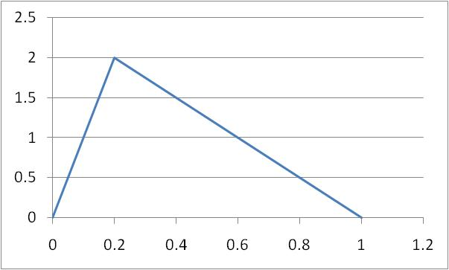
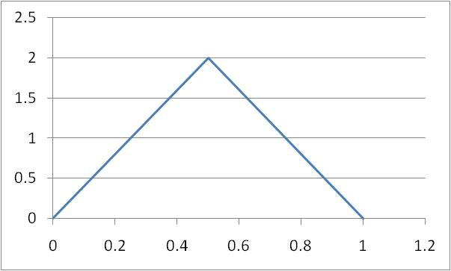
Example (Figure 9.2)
V₁
V₂

Slide 16
V₁ Mapping to U₁
V₁ | Percentile | U₁
0.2 | 20 | -0.84
0.4 | 55 | 0.13
0.6 | 80 | 0.84
0.8 | 95 | 1.64

Slide 17
V₂ Mapping to U₂
V₂ | Percentile | U₂
0.2 | 8 | −1.41
0.4 | 32 | −0.47
0.6 | 68 | 0.47
0.8 | 92 | 1.41

Slide 18
Example of Calculation of Joint Cumulative Distribution
Probability that V₁ and V₂ are both less than 0.2 is the probability that U₁ < −0.84 and U₂ < −1.41
When copula correlation is 0.5 this is
M( −0.84, −1.41, 0.5) = 0.043
where M is the cumulative distribution function for the bivariate normal distribution

Slide 19
Other Copulas
Instead of a bivariate normal distribution for U₁ and U₂ we can assume any other joint distribution
One possibility is the bivariate Student t distribution

Slide 20
5000 Random Samples from the Bivariate Normal. Correlation =0.5. (Figure 9.4)

Slide 21
5000 Random Samples from the Bivariate Student t (4 degrees of freedom, 0.5 correlation) (Figure 9.5)

Slide 22
Multivariate Gaussian Copula
We can similarly define a correlation structure between V₁, V₂,…V_{n}
We transform each variable V_{i} to a new variable U_{i} that has a standard normal distribution on a “percentile-to-percentile” basis.
The U’s are assumed to have a multivariate normal distribution

Slide 23
Factor Copula Model
In a factor copula model the correlation structure between the U’s is generated by assuming one or more factors.

Slide 24
Credit Default Correlation
The credit default correlation between two companies is a measure of their tendency to default at about the same time
Default correlation is important in risk management when analyzing the benefits of credit risk diversification
It is also important in the valuation of some credit derivatives

Slide 25
Copula Model for Loan Portfolio
We map the time to default for company i, T_{i}, to a new normally distributed variable U_{i} and assume
where F and the Z_{i} have independent standard normal distributions
The copula correlation is ρ=a²

Slide 26
Analysis
To analyze the model we
  Calculate the probability that, conditional on the value of F, U_{i} is less than some value U
  This is the same as the probability that T_{i} is less that T where T and U are the same percentiles of their distributions
  This leads to
  where PD is the unconditional probability of default in time T

Slide 27
The Model continued
Low values of F give high default probabilities
The value of F is that has an X% chance of being exceeded is −N⁻¹(X)
The “worst case default rate” that will not be exceeded with probability X during time T is therefore

Slide 28
Estimating PD and ρ
Table 9.6 shows that default rates ranged from 0.15% to 4.19% between 1981 and 2020 for all rated companies.
We can use this data in conjunction with maximum likelihood methods to estimate PD and ρ

Slide 29
Estimating PD and ρ continued
The probability density function for the default rate is
Maximizing the sum of the logarithms of this for the data in Table 9.6 we get PD=1.48% and ρ = 0.063

Slide 30
Probability Distribution for Default Rate (Figure 9.6)

Slide 31
Alternatives to the Gaussian Factor Copula
In
We can let the F and Z_{i} be non-normal distributions with mean zero and standard deviation one.

